Slide 1

BC2410, Prescriptive Analytics From Data to Decisions
A Brief Review of Lecture 8

Slide 2
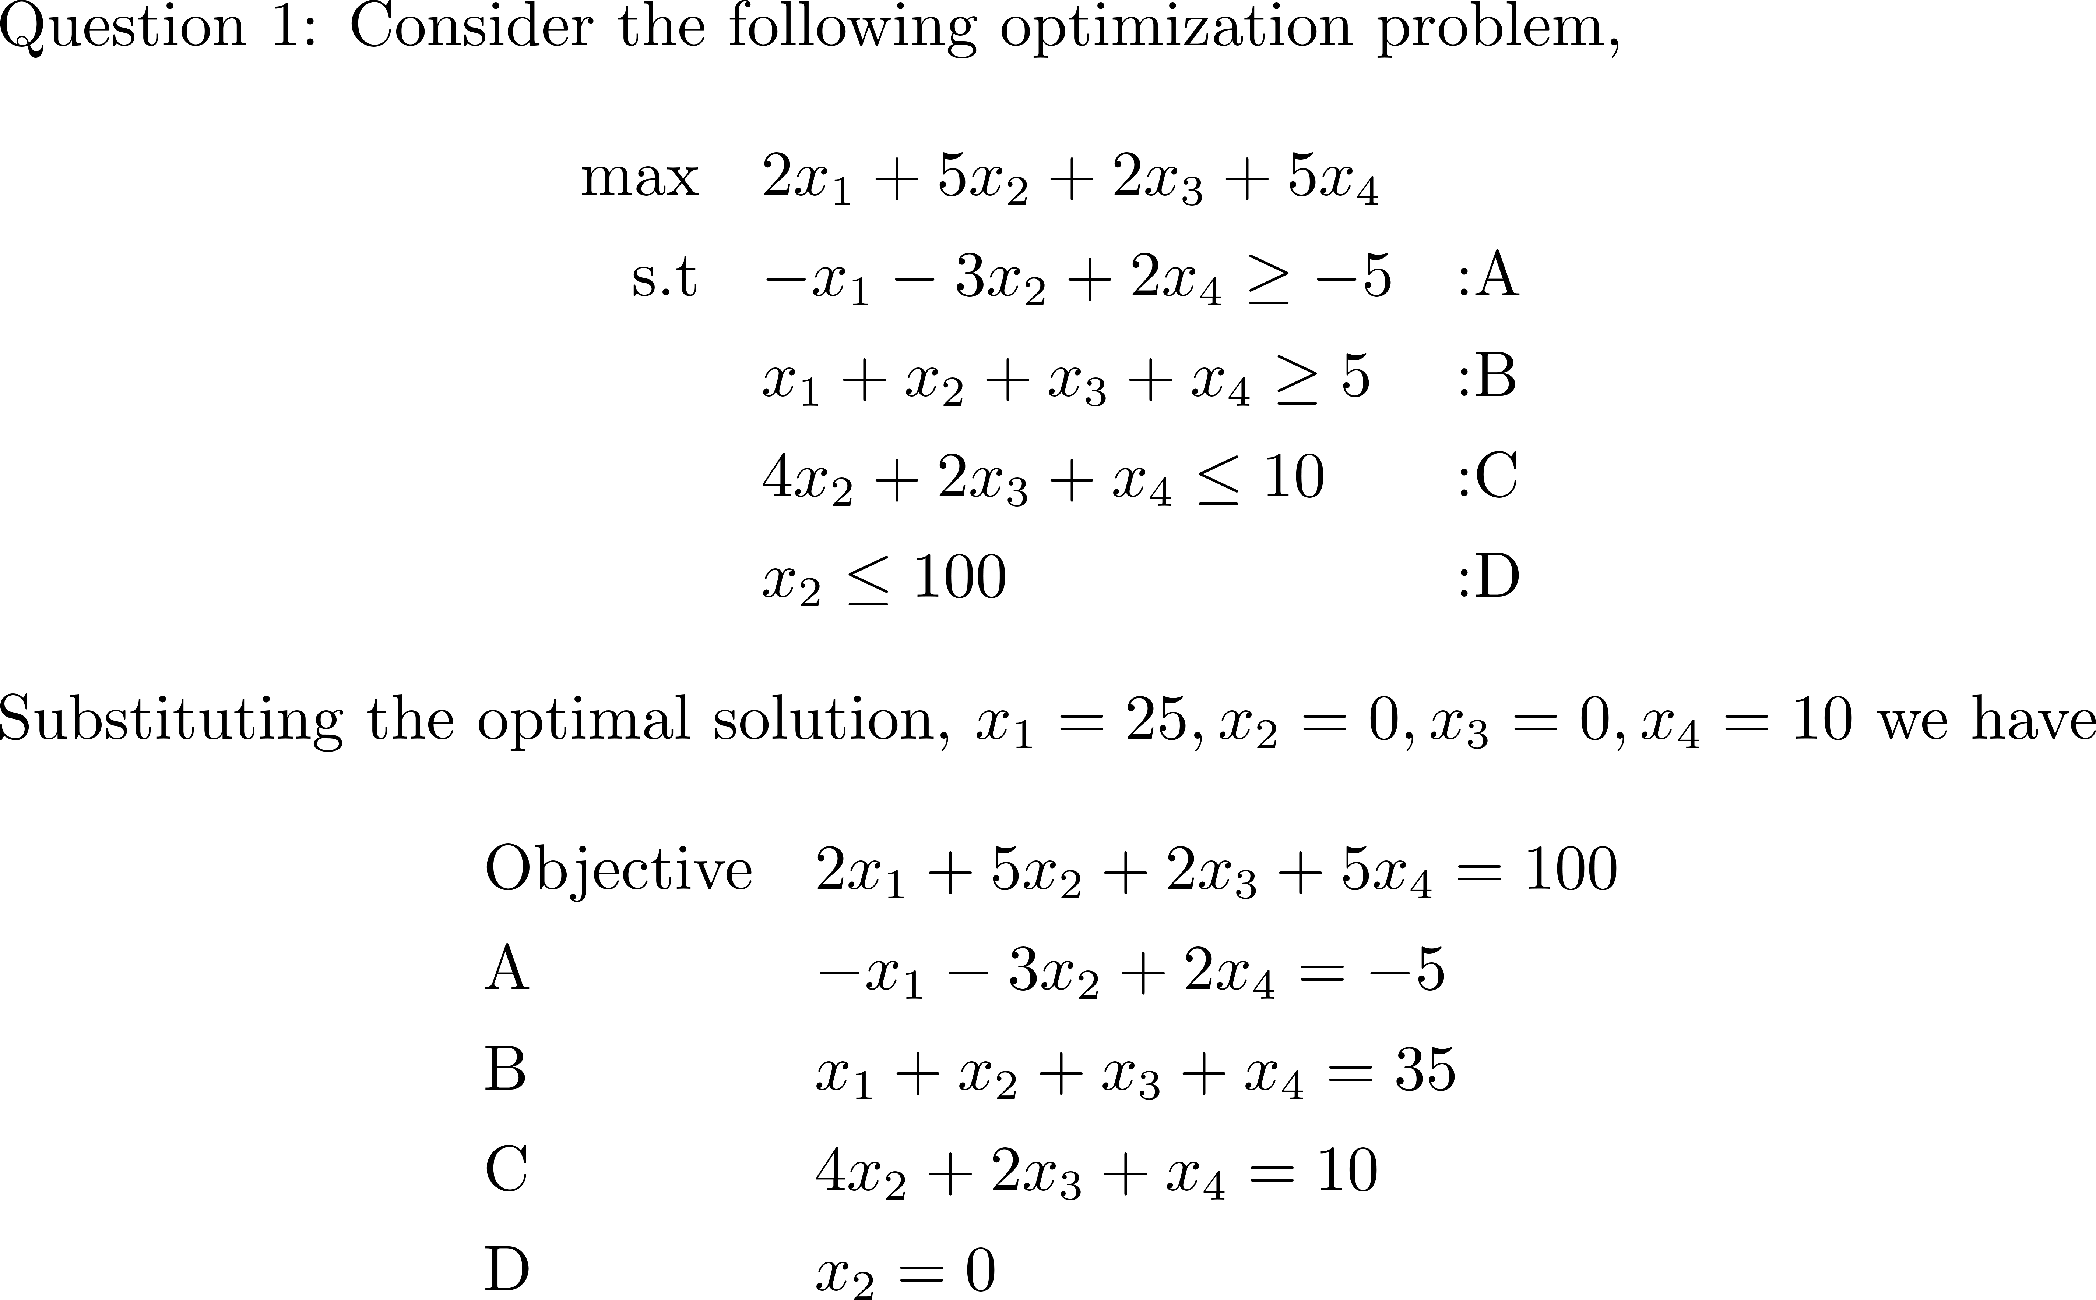
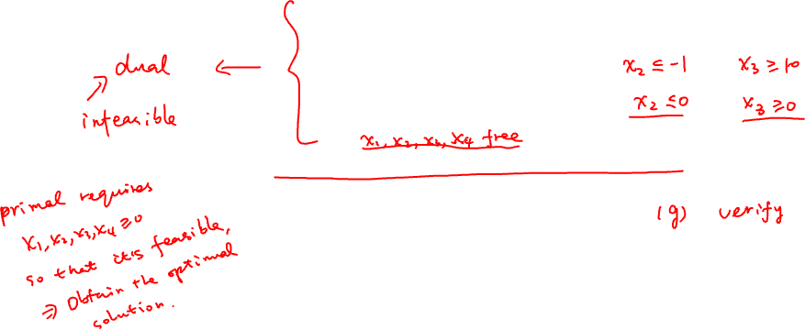
Assignment 3

Slide 3
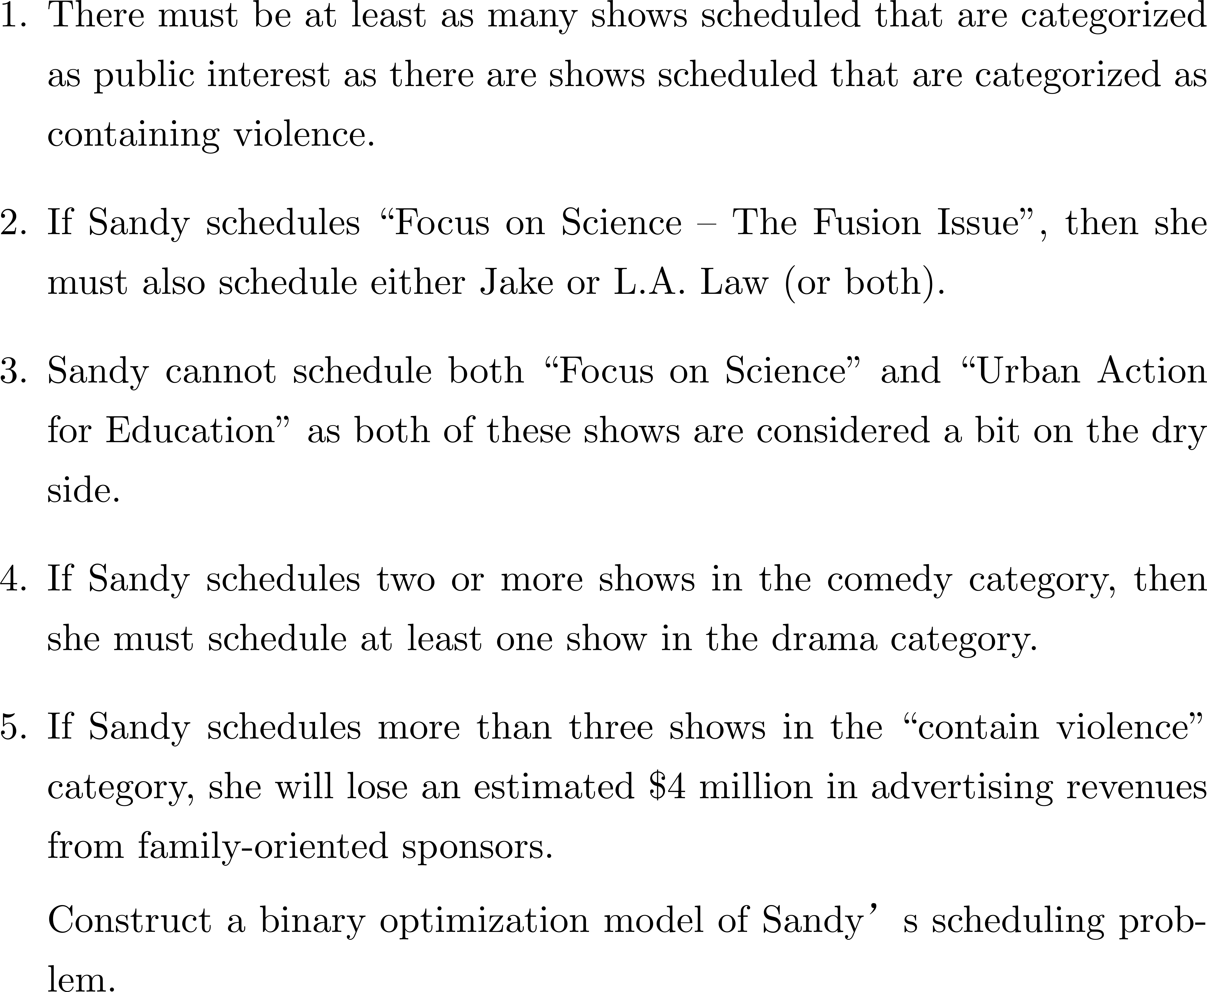
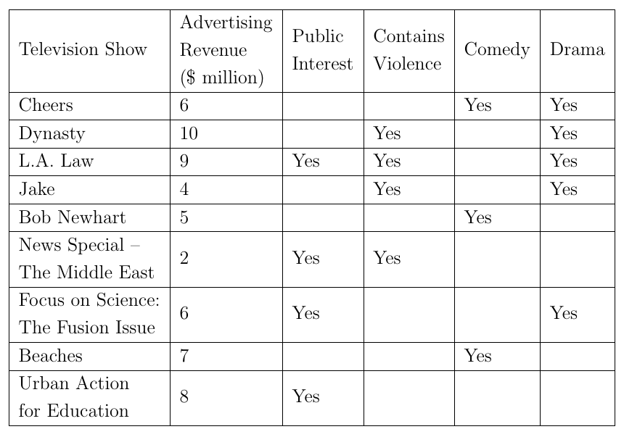
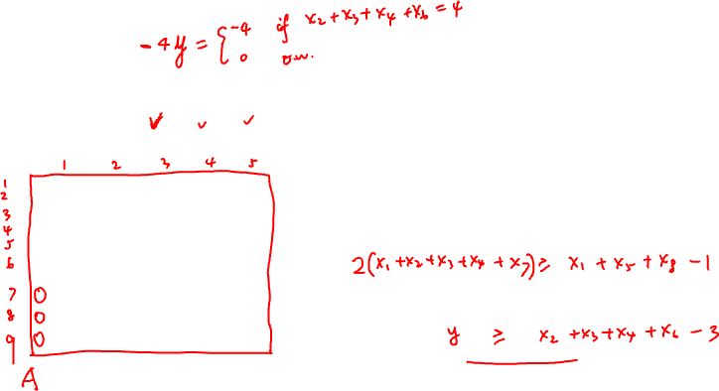
Assignment 3

Slide 4
Assignment 3

Slide 5
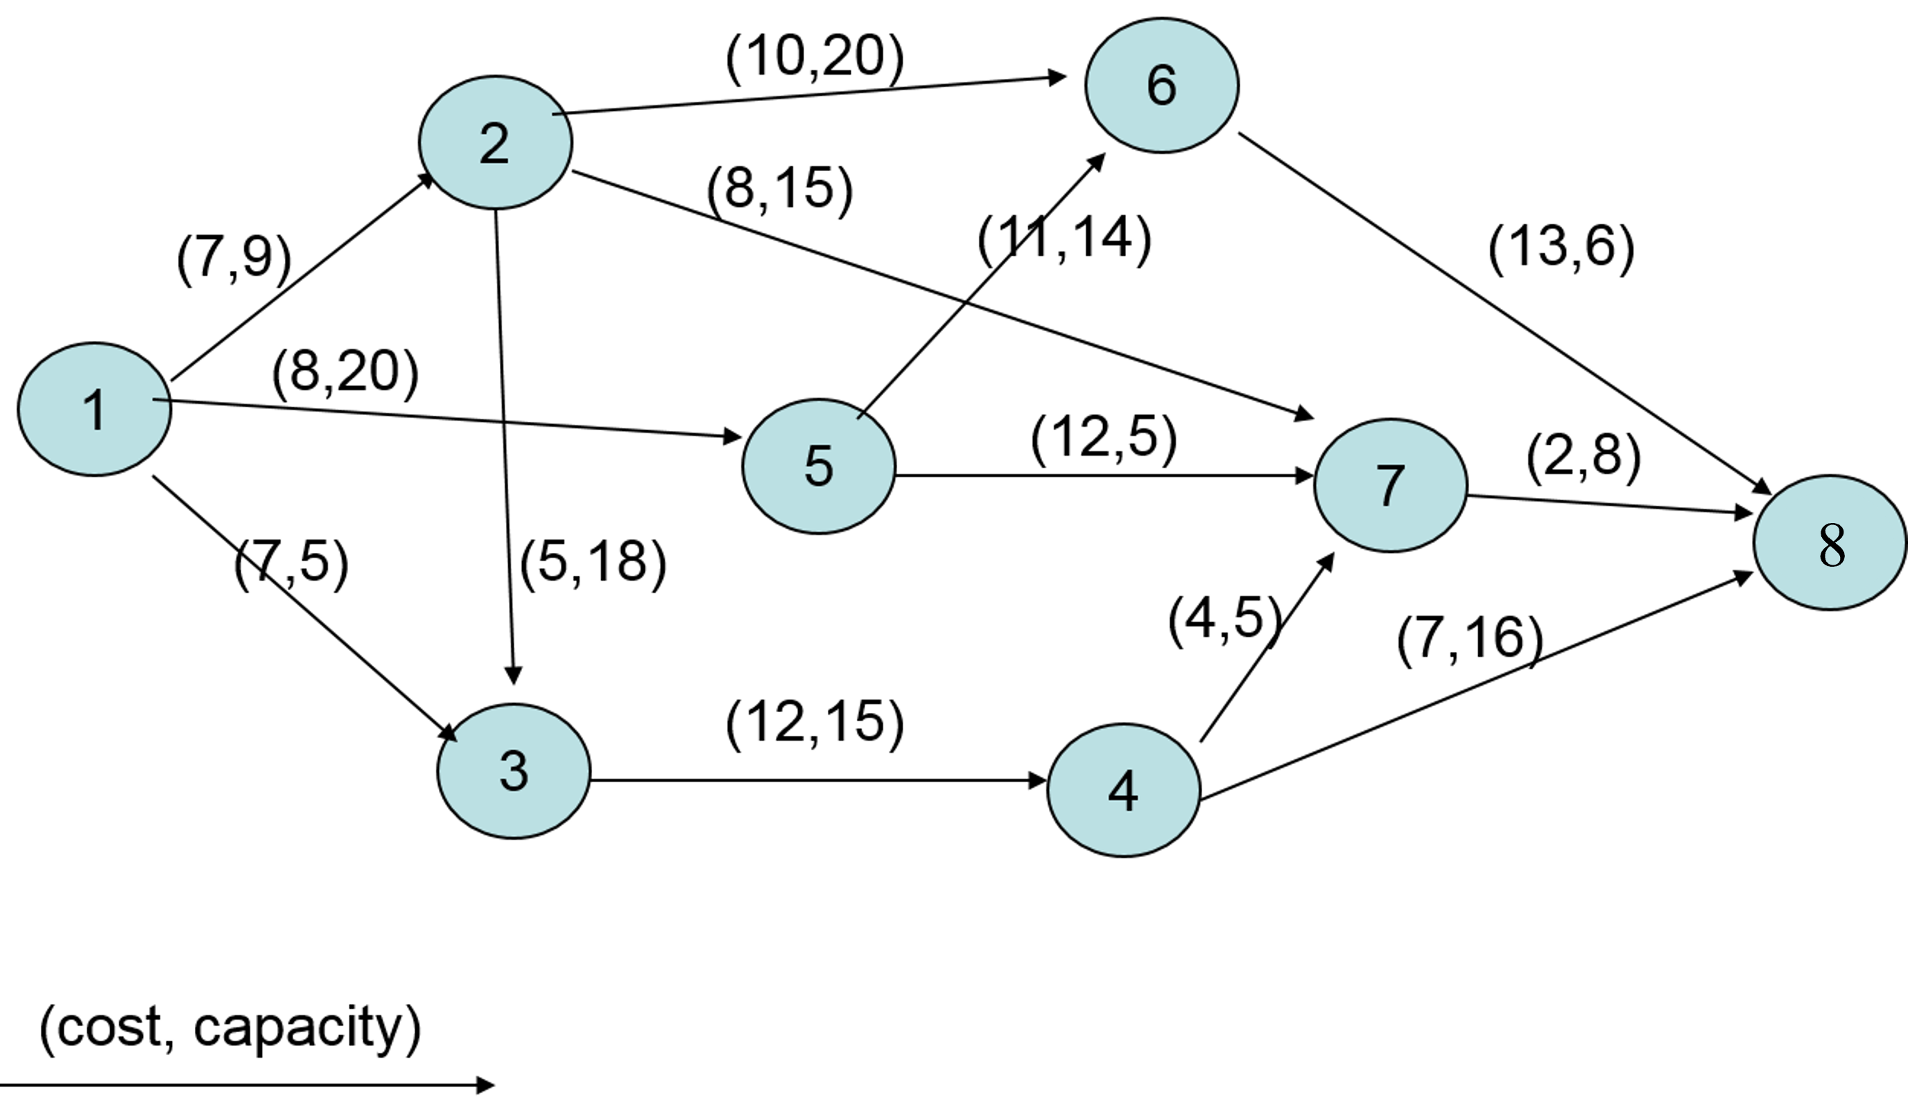
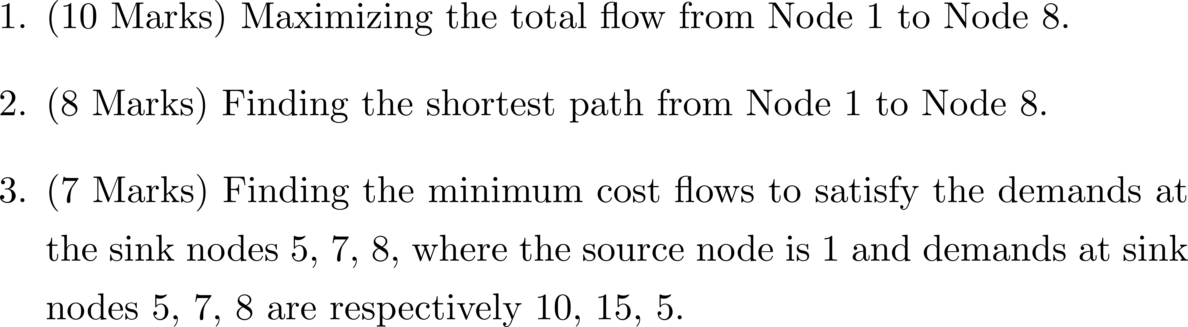
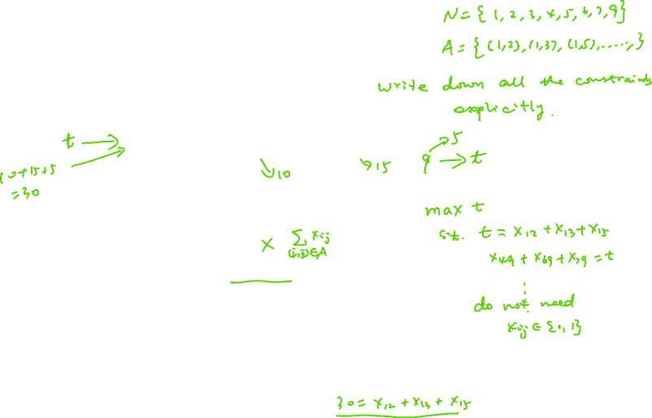
Assignment 3

Slide 6
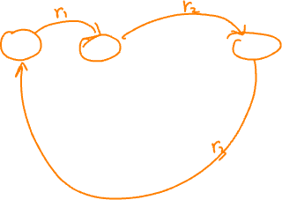
Arbitrage Detection
$ 1 = € r_{1,} € 1 = $ r₂
What happen if r₁ r₂ > 1?
No suppose you can exchange among n currencies, how can you detect whether there exists arbitrage opportunities?
 | USD | EUR | GBP | AUD | JPY
USD | 1 | 0.639 | 0.537 | 1.0835 | 98.89
EUR | 1.564 | 1 | 0.843 | 1.6958 | 154.773
GBP | 1.856 | 1.186 | 1 | 2.014 | 184.122
AUD | 0.9223 | 0.589 | 0.496 | 1 | 91.263
JPY | 0.01011 | 0.00645 | 0.00543 | 0.01095 | 1

Slide 7
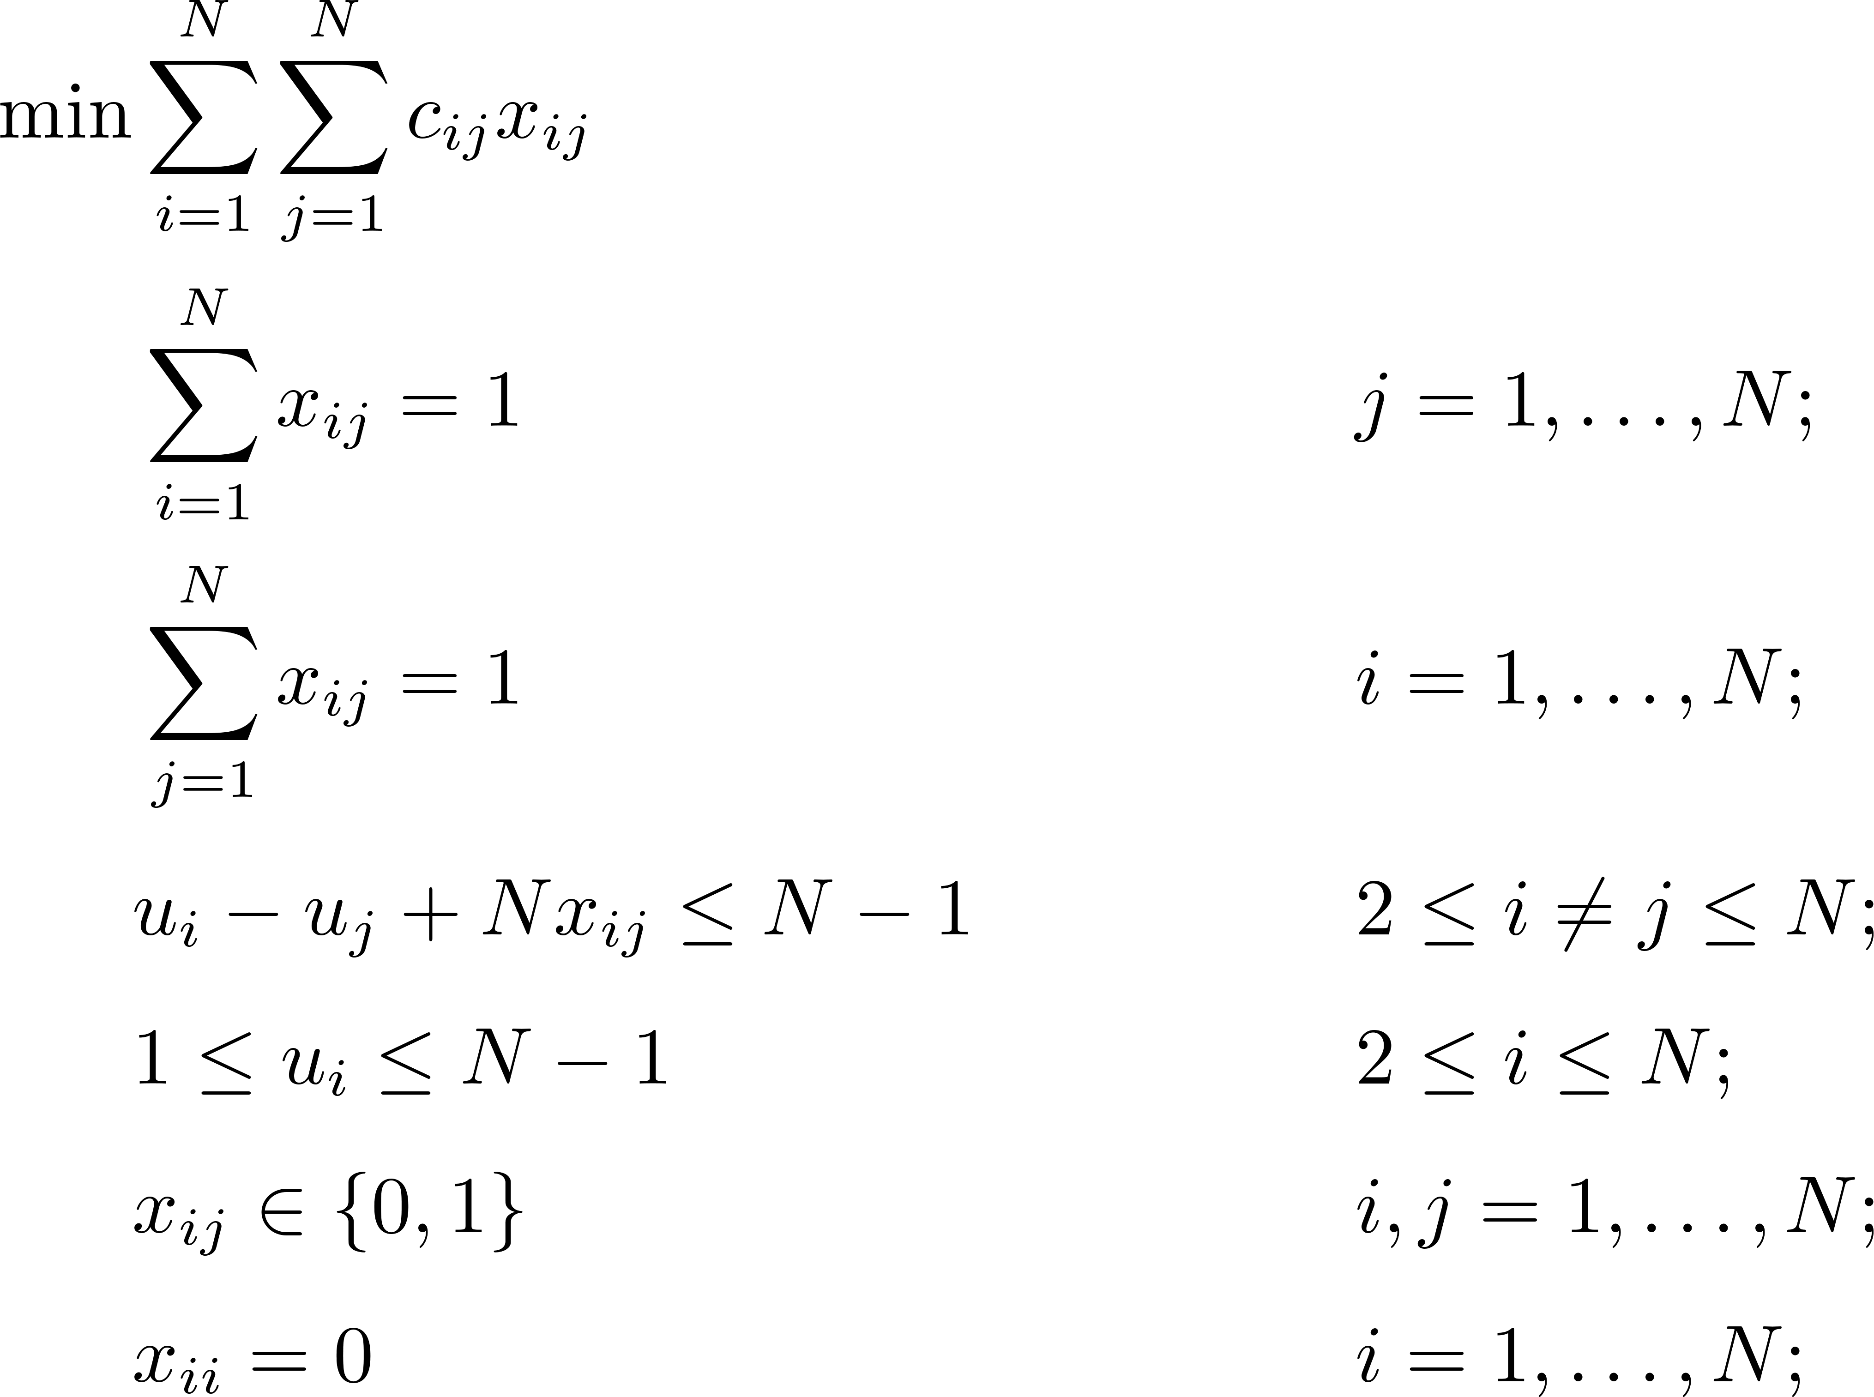
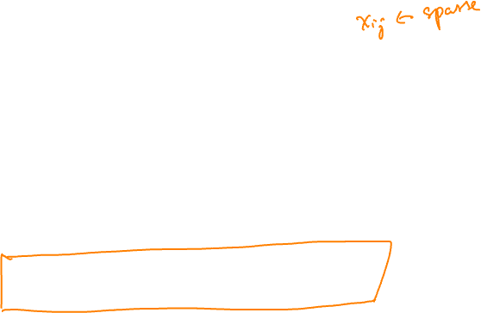
Traveling Salesman Problem
An integer programming approach
How about this model?
Miller–Tucker–Zemlin Formulation
Number of constraints vs. N?
Notes:
Subtour elimination: It excludes subtours, as (1) the arc-constraint for (i, j) forces uj ≥ ui + 1, when xij = 1; (2) if a feasible solution contained more than one subtour, then at least one of these would not contain node 1, and along this subtour the ui values would have to increase to infinity. This argument, with the bounds on the ui variables, also implies that the only feasible value of ui is the position of node i in the tour.

